Slide 1


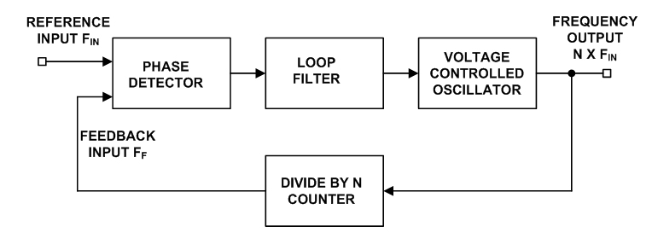
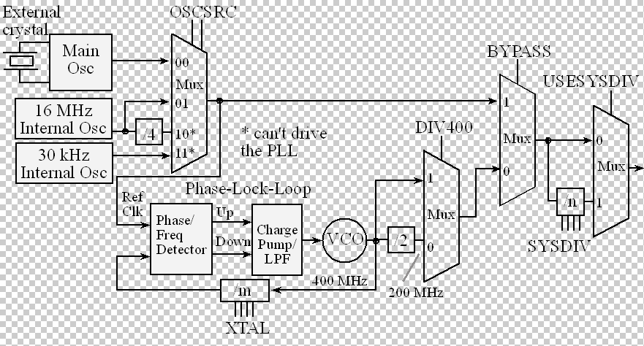
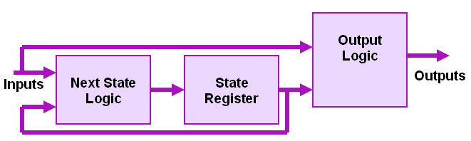
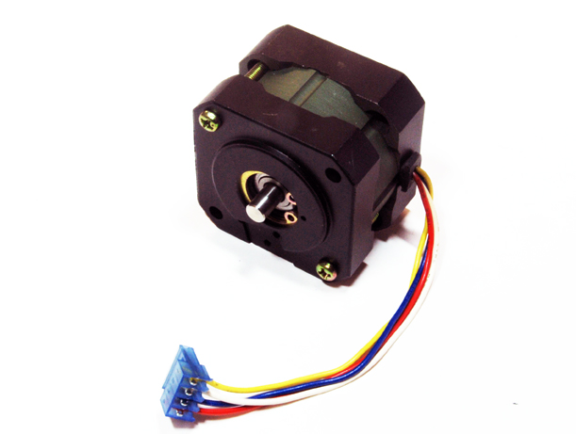
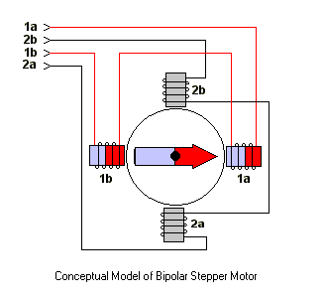
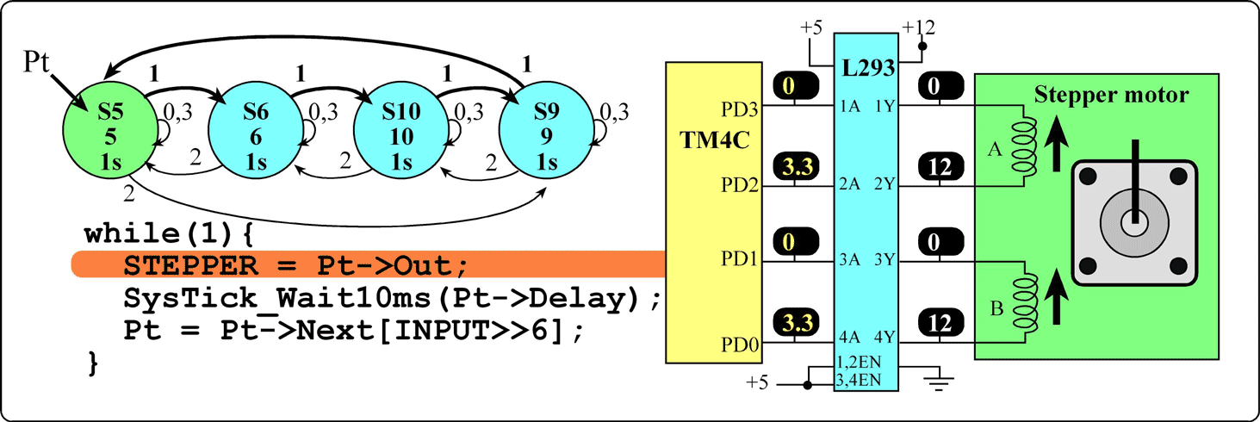
STEPPER BOT
FSM (Finite State Machines)
TExaS Instrument Launchpad Microcontroller (EK-TM4C123G)
Stepper Motors
By 1.)Rajat Bandejiya, 2.)Sudanshu Gupta
Introduction
To
Finite state machine
Phase Locked Loop
Description
Using the idea of FSM we will be mapping our System in this case our Stepper Robot to the abstraction of finite state machine and will dodge walls.
We will be using Phase locked loop to choose between system power and execution speed of computer(embedded system). Using this idea we can increase computer execution speed.
Systick timer is part of ARM processors. We will be using Systick Timer to produce accurate delays in the system.
Systick timer is used in RTOS.
A stepper motor is an electromechanical device which converts electrical pulses into discrete mechanical movements.
Data structures are generally based on the ability of a computer to fetch and store data at any place in its memory, specified by a pointer—a bit string, representing a memory address, that can be itself stored in memory and manipulated by the program
With the help of Data Structure we have created our State Transition Graph and combined all these above ideas, and hard coded on to our microcontroller to create a precise and Autonomous Robot.
A Finite State Machine (FSM) is an abstraction that describes the solution to a problem very much like an Algorithm. Many systems in engineering can be described using an FSM
a FSM describes the system (the solution being a realization of the system’s behavior) as a machine that changes states in reaction to inputs and produces appropriate outputs.
A significant amount of work is carried out in proposal and development of various theories and models in both the fields for their respective solutions [1, 2, 3].
A phase-locked loop or phase lock loop (PLL) is a control system that generates an output signal whose phase is related to the phase of an input signal.
Stepper motors are used in applications where precise positioning is more important than high RPM, high torque, or high efficiency.
The System Tick Timer (SYSTICK Timer) is a simple 24-bit down counter
Stepper motor
Finite set of states you can find your system
External inputs to your system
set of external outputs
explicit speciﬁcations of all state transitions
explicit specs of outputs determined
References
1.)Online Edx Course(How Embedded Systems Shape The World) By Jonathan Valvano and Ramesh Yeraballi
2.) Embedded Systems:Introduction to Arm(r) Cortex -M Microcontrollers: Jonathan W Valvano
Open House Exhibition, PLINTH 2016

